Slide 1
Free will, determinism, and responsibility
Prepared by the Ian Ramsey Centre

Slide 2
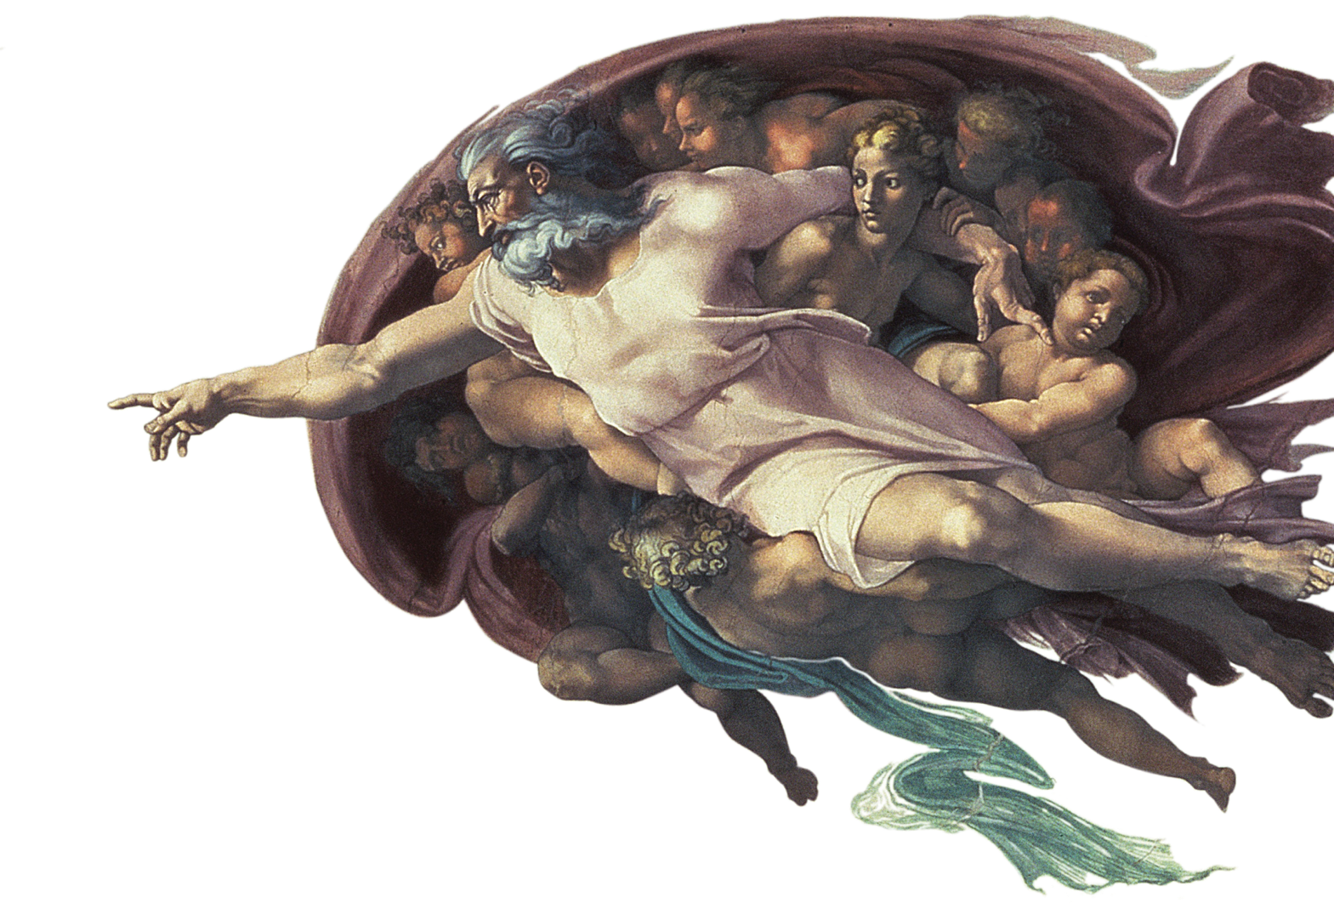
What is the debate about free will, determinism, and responsibility?
Cases for the different views
Theological determinism
Concluding remarks

Slide 3
What is the free will versus determinism debate?

Slide 4
Defining the words and the debate
Free will is a purported human faculty, existence of which implies that at least some of our actions originate with ourselves, in other words we initiate and control them.
Determinism is the view that everything that happens is fixed, i.e. “determined,” by whatever has already happened.
Moral responsibility is the view that we can be considered as accountable for what we do.
There is a long-standing debate about these matters, especially since the rise of early modern science, since determinism appears to conflict with free will and hence moral responsibility.

Slide 5
The main views in the debate
Start
Is the cosmos deterministic?
YES
NO
Is determinism compatible with free will?
NO
YES
(A) Incompatibilism: Free will is impossible
(B) Compatibilism: Free will is possible
(C) Free will is possible

Slide 6
The case for incompatibilism

Slide 7
Incompatibilism
Incompatibilism is the position that a deterministic universe is completely at odds with the notion that people have a free will.
In a modern sense determinism roughly means the following:
“The world is governed by (or is under the sway of) determinism if and only if, given a specified way things are at a particular time, the way things go thereafter is fixed as a matter of natural law.”
Hoefer, Carl, "Causal Determinism", The Stanford Encyclopedia of Philosophy (Spring 2016 Edition), Edward N. Zalta (ed.), URL = https://plato.stanford.edu/archives/spr2016/entries/determinism-causal/

Slide 8
Incompatibilism
According to an incompatibilist, whatever goes on after time t is fixed by whatever has already gone on up to and including time t. One cannot choose to do other than what one does at time t.
Since it is quite widely believed that free will requires the ability to do other than one does, and since determinism excludes this possibility, determinism and free will are incompatible.
On this account, anyone who thinks philosophically about the world must choose to believe either in determinism or in free will but not in both (although of course, on this view plus determinism, there is only the illusion of choice).

Slide 9
Compatibility with physics?
Determinism seems to align well with how physics has described the world since the rise of early-modern science, especially the success of Newton’s Law of Gravitation and his Laws of Motion in predicting the movements of the planets.
On this account, the solar system is usually modelled as the sum of the orbits of each planet, assuming that each planet is only attracted by the sun. Applying Newton’s laws, if we know all the relevant initial conditions (positions, masses, velocities) at time t, we know where the planets will be after time t.
These orbits are indeed (almost) perfectly predictable and machine-like. Hence, in the 18th century, the known solar system was often modelled like a machine, an “Orrery”.

Slide 11
Reducibility to deterministic components
In the case of the solar system, the system as a whole can be treated, almost, as the sum of all the behaviours of all the planets separately, i.e. assuming that one can neglect the interactions of the planets on one another. In this case, it is almost true that the whole is the sum of the parts.
In these situations, we say that the system is reducible to the sum of its parts, and each part, namely each planet-sun component, has a machine-like, deterministic orbit.
From this example, the conclusion is often drawn that other complex systems, including chemical and living systems, are also reducible to their parts. And if the parts are all machine-like and deterministic, and the whole is the sum of the parts, then the whole is also ultimately deterministic.

Slide 12
The case for incompatibilism
Incompatibilism appears to be compatible with science or even required by science (or at least 18th century science) and is quite widely believed by philosophers and many others.
Even though incompatibilism implies the need to jettison belief in free will, except as a convenient illusion, other possibilities open up. For example, we can try to treat human beings in a similar way to Newtonian systems in physics, namely by measuring external variables and looking for patterns and laws. This thinking gave rise to behaviourism in psychology.
Influential incompatibilists include Baruch Spinoza, John B. Watson, Ivan Pavlov, and Ted Honderich.

Slide 13
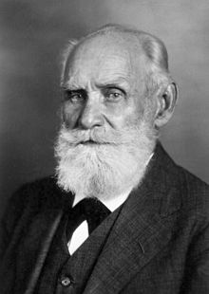
Pavlov’s dogs
Behaviourism explains human and animal behaviour in terms of external conditioning, without appeal to thoughts or feelings. Whatever one thinks that one thinks or feels does not matter anyway, on an incompatibilist view.
One of the most famous behaviourist experiments was that of Pavlov’s dogs. Ivan Pavlov successfully conditioned dogs to salivate at the sound of a bell, having previously conditioned the dogs by associating this sound with being fed.
Ivan Pavlov, 1849-1936 (source: Wiki, unknown origin)

Slide 14
The death of life and free will?
Given the apparent success of machine-like metaphors for the world, and the ability to condition even living things to respond automatically to stimuli, it has seemed to many that we no longer really need a concept of life, or mind, or the will. Everything is simply a very complex machine, and what appears to us as life or choice is simply an illusion.
These themes are explored in another picture from the 18th century by Joseph Wright of Derby, An Experiment on a Bird in the Air Pump, in which a bird is suffocated as viewers watch.
Examine this picture on the next slide and ask yourself, “What does the scene in this picture look like?” It should remind you of a scene in some of the pictures seen on cards once a year.

Slide 15
An Experiment on a Bird in the Air Pump 1768 oil-on-canvas painting by Joseph Wright of Derby

Slide 16
The case for compatibilism

Slide 17
Compatibilism
Compatibilism is the thesis that free will is compatible with determinism. This position encompasses a variety of views, and the arguments with incompatibilists are ongoing.
Since free will is usually taken as a condition of moral responsibility, compatibilism is also sometimes described as thesis of the compatibility of determinism and responsibility.

Slide 18
Versions of compatibilism (1)
The earliest version of compatibilism involves defining free will in terms of a positive component, namely doing what one inclines to do, and a negative component, namely being unimpeded in doing what one inclines to do. This position is most closely associated with Thomas Hobbes.
Determinism is compatible with both these components, and hence is compatible with free will.
Objectors to this position challenge whether what is meant by “free will” can legitimately be reduced to these components. For example, can someone who acts unimpeded as a result of a mental illness really be considered to have free will?

Slide 19
Versions of compatibilism (2)
Free will is usually associated with the ability to do other than one does. Unlike in Hobbes’ account, compatibilists and incompatibilists today usually assume this premise.
A more modern argument for compatibilism is that determinism is a thesis about what must happen in the future given the actual past. Hence, determinism is consistent with the future being different given a different past, and therefore it is possible to choose to do other than one does.
A modern objection is that an agent is still determined at the time of action to have the desires that she has, and therefore is unable to do other than she does in the relevant sense.

Slide 20
Three contributions from the 1960s
According to the Consequence Argument, no one has power over the laws of nature or the facts of the past, or (by determinism) over the future. So, by determinism, no one has power over the future, implying there is no effective free will.
Harry Frankfurt attacked the Principle of Alternative Possibilities (PAP), giving counterexamples in which someone is morally responsible even though unable to do otherwise.
Peter Strawson argued that we react not just to actions but perceived intentions in other people and we ascribe moral responsibility on this basis. It would be practically impossible to imagine how these reactions could be discarded in real life.
Debates arising from these contributions are ongoing.

Slide 21
The case for denying universal determinism

Slide 22
The missing option
As noted previously, Strawson underlined the practical impossibility of denying moral responsibility, which is closely associated with belief in free will. Also as noted previously, the possibility of the compatibility of determinism with free will is still a matter of active debate.
But is this debate really the right one to focus on? Not all of the natural world seems so deterministic as the orbits of planets in the solar system. There is also spontaneity, as in radioactive decay and other phenomena in quantum mechanics.
Although animals can be conditioned, like Pavlov’s dogs, they also often exhibit what look like actions that are voluntary and selected from diverse possibilities. Animals of the same species can also show diverse characteristic behaviours.

Slide 23
Pavlov’s dogs, or any dogs, can do much more than salivate to the sound of bells
Dogs playing
Source: Bigstock ID: 373958239 Copyright: chalabala

Slide 24
Spontaneity in nature
Dandelion seeds being distributed by the wind
Source: Bigstock ID: 283640485 Copyright: gan chaonan

Slide 25
The glow of spontaneous nuclear decays
The reactor pool at the High Flux Isotope Reactor, Oak Ridge National Laboratory, United States.
Source: oakridgelabnews via Flickr, distributed under a Creative Commons Licence

Slide 26
Is determinism an illusion?
Modern determinism started with the success of Newton’s laws, which can be used to compute the orbits of planets. The orbits appear deterministic enough that the solar system can be modelled quite well as a machine.
Setting aside these special cases, however, a lot of things behave as if they initiate action, not just because of prior conditions. For example, as noted above, dogs select actions when they play; winds blow seeds in random directions; and nuclear decays can only be predicted statistically at best.
Some things in nature seem deterministic, but not all.

Slide 27
Is determinism an illusion?
… and even modelling the solar system as a machine is not quite correct. The mathematics only work perfectly if each pair of interactions of a planet and the sun can be treated in isolation from all other interactions, especially by neglecting the much smaller gravitational pull of the planets on one another.
If we try to include all the interactions, it is impossible to integrate the forces to produce an equation of motion connecting past, present, and future. We can generate good approximations but they are never completely correct.
The picture of the world governed by Newtonian mechanics is really that of an approximation, a useful but simple idealisation.

Slide 28
Complex ‘chaotic’ systems
In recent decades, since the work of Edward Lorenz, we have started to built approximate simulations of some of these complex systems, which are so common in nature.
One thing we have learned is rather surprising. Many complex systems evolve towards final states, rather like the way in which living and growing things develop into final forms (called ‘strange attractors’). On this account, many things in nature appear more biological than mechanical in their behaviour.
This fact, in itself, does not disprove determinism, but it shows that causation in nature is more complex than the pushes and pulls of machines. Indeed, it may be more appropriate to think of the cosmos by the metaphor of a garden than a machine.

Slide 29
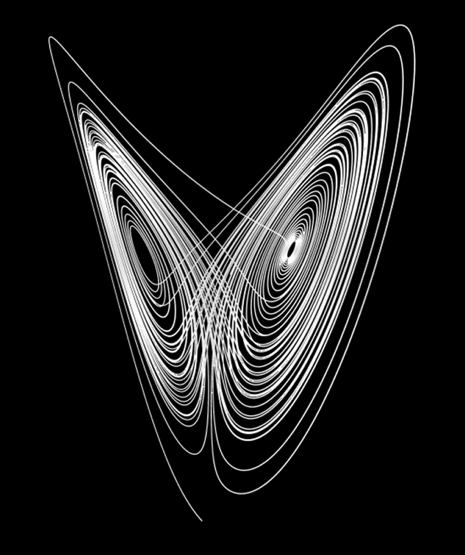
Examples of the vast range of self-organising systems in nature
From left to right: the ‘strange attractor’ of the Lorenz equations; a snowflake; and a single flower (Source: public domain images)

Slide 30
More than machines?
Another way to think of this problem is to challenge reducibility, i.e. the assumption that biology reduces to chemistry, which reduces to physics. And since the simplest systems in physics seem deterministic, everything is deterministic.
But it is unclear that it is valid to make this assumption. The laws of physics describe mathematical ideals, namely simple systems isolated from all other influences. But an atom that is part of a complex structure, such as a rhinoceros or a man, is certainly not isolated, but behaves as part of these beings.
For example, the motion of an atom on the tip of the horn of a rhinoceros is best understood in terms of the behaviours and decisions of the rhinoceros.

Slide 31
Does the carbon atom at the tip of the horn of a rhinoceros behave like a free atom in space? Or does it behave like an atom embedded in a rhinoceros, moving according to the voluntary actions of the rhinoceros?
Source: Bigstock ID: 346069003 Copyright: gan chaonan

Slide 32
The situation today
Belief in determinism is linked to the success of early-modern physics, and it remains true that many systems can be modelled successfully in this way, to a good approximation.
BUT contemporary physics has also underlined that many other systems cannot be modelled in this way, as a sum of simple deterministic systems. Atoms in snowflakes, or flowers, or animals, behave as parts of these wholes, exhibiting both end-directed behaviour and spontaneity.
People will no doubt continue to believe in determinism, but such a belief should NOT be treated as one that is ‘determined’ by physics, so that alternatives are impossible. The cosmos is arguably more like a garden than a machine.

Slide 33
Theological determinism?

Slide 34
Determinism and theology
The purported benevolent divine direction of the cosmos and human affairs is often called providence, drawn from the Latin providere, meaning to ‘foresee, attend to’.
In Christianity, the divine direction of a life towards salvation in heaven is often called predestination, from the Latin praedestinare, meaning to ‘make firm beforehand.’
At least since the 16th century among Christians, there have been some long-standing disputes about predestination. In particular, if God directs a person to heaven, is this an infallible divine determinism? In other words, can anything that the person does influence or change this destiny?

Slide 35
The logical problem
If it is said that there is divine determinism, this preserves belief about the omnipotence of God at the cost of overriding any exercise of free will about one’s ultimate fate.
On the other hand, if it said that human beings can and do exercise free will about their ultimate fate, then this appears to place God in a subordinate position. In addition, how can one desire ultimate goodness without already being good?

Slide 36
Finding new perspectives from stories (I)
One way of trying to resolve this problem is to look at the actual working out of salvation in particular stories.
For example, inspired by 1 Corinthians 10:1-4, one can regard the story of the Book of Exodus in the Old Testament as the story of the salvation of souls from Baptism (crossing the Red Sea) to the kingdom of heaven (the Promised Land).
All the souls in the account are directed to salvation, which is an extended process taking forty years in the story. Divine action initiates and direct the journey, but the choices of human beings also count decisively. In practice, the majority of people who start the journey do not finish.

Slide 37
Finding new perspectives from stories (I)
Another story of salvation is the Parable of the Sower, which is told by Jesus Christ in the New Testament: “A sower went out to sow. And as he sowed, some seeds fell along the path, and the birds came and devoured them. Other seeds fell on rocky ground, where they had not much soil, and immediately they sprang up, since they had no depth of soil, but when the sun rose they were scorched; and since they had no root they withered away. Other seeds fell upon thorns, and the thorns grew up and choked them. Other seeds fell on good soil and brought forth grain, some a hundredfold, some sixty, some thirty.”
Matthew 13:1-23. Cf. also Mark 4:1-20 and Luke 8:1-15. The text here is from Matthew, using the Revised Standard Version translation

Slide 38
The Parable of the Sower

Slide 39
Finding new perspectives from stories (I)
As in the case of Exodus, this parable is about salvation. The growth of the plants would be absolutely impossible without the divine intervention of sowing the seed.
BUT the drama is one in which the state of the ground and hence human responsiveness plays a role. There are unsuccessful as well as successful outcomes.
The degrees of fruitfulness also hint at the notion that diverse ground, given the same seed, bears different quantities of fruit, implying also that one’s choices within the Christian life generate diverse blessedness in the kingdom of heaven.

Slide 40
Organic metaphors
As in the case of the shift in models from being machine-like to more organic, perhaps also divine predestination needs to be imagined more in organic rather than formal terms.
Both Exodus and the parable of the sower imply that divine action is absolutely primary. But human action also plays a role, especially the need for consent to the divine will.
In addition, everyone in both stories is directed to salvation, as implied by the notion of predestination, but not all attain it. In theology, this category is incomplete predestination.
As a parallel, one can think of the organic metaphor of a plant. All the matter of the plant is directed to its fruitfulness, but plants can still wither or be cut off before bearing fruit.

Slide 41
Conclusions

Slide 42
Concluding remarks
Belief in the determinism of the world, encouraged by early modern science, or belief in the theological determinism of God have both seemed to override any role for free will. Allowing a role for free will seems to give rise to impossible problems.
The underlying problem in both cases may really be a narrow way of imagining the world. If we imagine the world as being like a machine, then only the previous actions of the machine and its designer are important in determining what happens.
New developments in science and a renewed appreciation of Biblical stories and parables feed our imaginations in different ways. Created beings, like life in a garden, have their own proper causal actions, and divine action can perhaps be better thought of as the work of a gardener than a watch-maker.

Slide 43
Further reading and viewing
Short videos (on providence)
3-minute video by the Ian Ramsey Centre: https://www.youtube.com/watch?v=Ktz-KVmsKV8
1-minute cartoon by the Ian Ramsey Centre, “Albert Explores”: https://www.youtube.com/watch?v=dN9YhngPNGI
Bibliography and further reading
Hoefer, Carl, "Causal Determinism", The Stanford Encyclopedia of Philosophy (Spring 2016 Edition), Edward N. Zalta (ed.), URL = https://plato.stanford.edu/archives/spr2016/entries/determinism-causal/
Newman, John Henry, ‘A Particular Providence as Revealed in the Gospel’, in Parochial and Plain Sermons, Revised ed. edition (San Francisco: Ignatius Press, 1997), p. vol. 3, sermon 9. http://www.newmanreader.org/works/parochial/volume3/sermon9.html

Slide 44
Creation: more like a garden than a machine? Treat it responsibly
Adam and Eve in the Garden of Eden by Jan Brueghel the Elder (Source: Public domain)

Slide 45
This publication was made possible through the support of a grant from Templeton World Charity Foundation, Inc. The opinions expressed in this publication are those of the authors and do not necessarily reflect the views of Templeton World Charity Foundation, Inc.

